Slide 1

Notes:
The MYOB Way
https://youtu.be/jEI3wU89VXo

Slide 2

Notes:
Lets talk perks

Slide 3
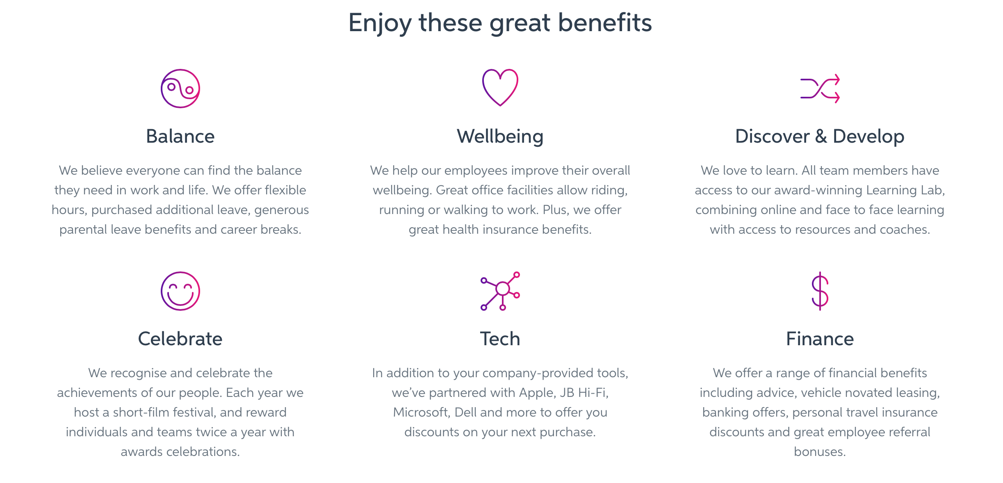

Slide 4
Your journey as a MYOB candidate

Slide 5
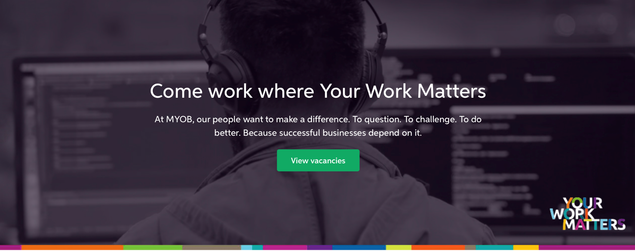
Check out our jobs and apply at https://www.myob.com/au/careers

Slide 6
Notes:
We are in New Zealand and Australia.

Slide 7
Our Platform Experience and Platform Delivery team
Business Analyst
Developers & DevOps Engineers
Quality Analysts
Development Lead
UX & UX Researchers & Visual Designers
Agile Coach
Product Manager
Development Manager

Slide 8
Have a chat with one of our Digital Talent Advisors

Slide 9
If mutually pumped about your fit for the role, and you’re a developer, the next step will be to complete our coding exercise
Notes:
Coding exercise is done in your own time – it is not a timed exercise.

Slide 10
Your Digital Talent Advisor will provide code feedback and OR next steps

Slide 11
Interview break down for Developers
3 hour session
1st hour – cultural discussion
2nd hour – Technical discussion
3rd hour – Pairing session
*Try meet as many team members as possible
Notes:
Cultural interview.
Understanding your motivations, attitude toward technology, what you are passionate about. As well as an opportunity for you to ask lots of questions to learn more about the team and business.
We purposely do 3 hours to provide an opportunity for them to get a real view of what it would be like to work at MYOB. Also to meet as many team mates as possible.

Slide 12
What if I am not a developer?
Every interview at MYOB includes a cultural and technical (skill based) session.
Business Analysts and Product Managers are presented with scenarios.
Designers
Includes a design challenge
DevOps and QAs
Coding challenges too

Slide 13
Your Digital Talent Advisor will provide interview feedback OR next steps

Slide 14
You’re successful for the role
Verbal offer pending 2 x reference checks and visa approval
Letter of offer emailed to you – full digital on boarding experience which we call Immersion, including a Virtual Reality welcome

Slide 15
MYOB Relocation Package. We got this!
Notes:
Before you depart
We’ll cover:
Direct economy flights, cabs and transfers for you and any immediate family that are relocating with you
Any Visas or Work Permits
Travel Insurance for medical and emergency situations
A Hotel stay for the night before you depart
On arrival
We’ll cover:
Reasonable accommodation in a hotel or serviced apartment (4-8 weeks)
Car hire for up to 8 weeks
Reasonable costs associated with shipping personal effects
5 days Paid Relocation Leave
Reasonable costs relating to the relocation of pets

Slide 16

Notes:
https://www.youtube.com/watch?v=52THVcWXvOw&sns=tw

